Slide 1

Artificial Intelligence A hands-on introduction to Artificial Neural Networks and Tensorflow.
16/11/2018
Notes:
Check everyone has Tensorflow installed.

Slide 2
Artificial Intelligence & Machine Learning
Artificial Intelligence
Artificial Intelligence is the collection of capabilities and behaviours by systems that are perceived by humans as intelligent.
Anne Laure Thieullent, Capgemini Global Head of AI, I&D
Machine Learning
Machine learning is a field of artificial intelligence that uses statistical techniques to give computer systems the ability to "learn" (e.g., progressively improve performance on a specific task) from data, without being explicitly programmed.
Wikipedia - https://en.wikipedia.org/wiki/Machine_learning
Notes:
Because no one can agree on definitions, here are two example ones.
AI – interesting to note Capgemini have based it on what humans think; i.e. if you think it is AI it is AI – bit of a cop out.
ML – learning element is key and shared among definitions.

Slide 3
Optical Character Recognition
Current OCR programs/systems:
OpenCV
Tesseract
Amazon Rekognition
Various smart phone apps
We, however, will be building one from scratch using Tensorflow.
Notes:
It is almost all ways better to use opensource software for OCR – a lot of research has gone into this problem.
But this means it is a great play ground for beginners – a lot of the problems are not only solved but well documented, and there are plenty of tutorials available.

Slide 4
Tensorflow
Python Library originally developed by Google for internal use, but now released on an opensource license.
Provides functions for Machine Learning, in particular developing Artificial Neural Networks (ANNs).
Allows for easier development and experimentation in the Machine Learning space, but does require Python knowledge.
Websites:
https://github.com/tensorflow
https://www.tensorflow.org/

Slide 5
Tensorflow – Set Up
Tensorflow installation require a python environment to already be set up on your computer.
https://www.tensorflow.org/install/
Online tool that allows you to run Tensorflow code in your browser (bit slow):
https://colab.research.google.com/notebooks/welcome.ipynb#scrollTo=1NFXGrpTnXxV
Python set-up can be difficult on Windows. Anaconda is a easy Python distribution for Windows.
https://www.anaconda.com/download/
Notes:
Check up

Slide 6
Everyone set up?

Slide 7
Data
Good data for training and testing/validation is key for Machine Learning. One of the reasons AI has become promising in the past decade is the raise of Big Data.
Data requirements:
Enough
Unbiased
Suitable format
(Labelled)
Notes:
Might need to add some more info in here – quotes, issues with data?
Training Dataset: The sample of data used to fit the model.
Validation Dataset: The sample of data used to provide an unbiased evaluation of a model fit on the training dataset while tuning model hyperparameters. The evaluation becomes more biased as skill on the validation dataset is incorporated into the model configuration.
Test Dataset: The sample of data used to provide an unbiased evaluation of a final model fit on the training dataset.

Slide 8
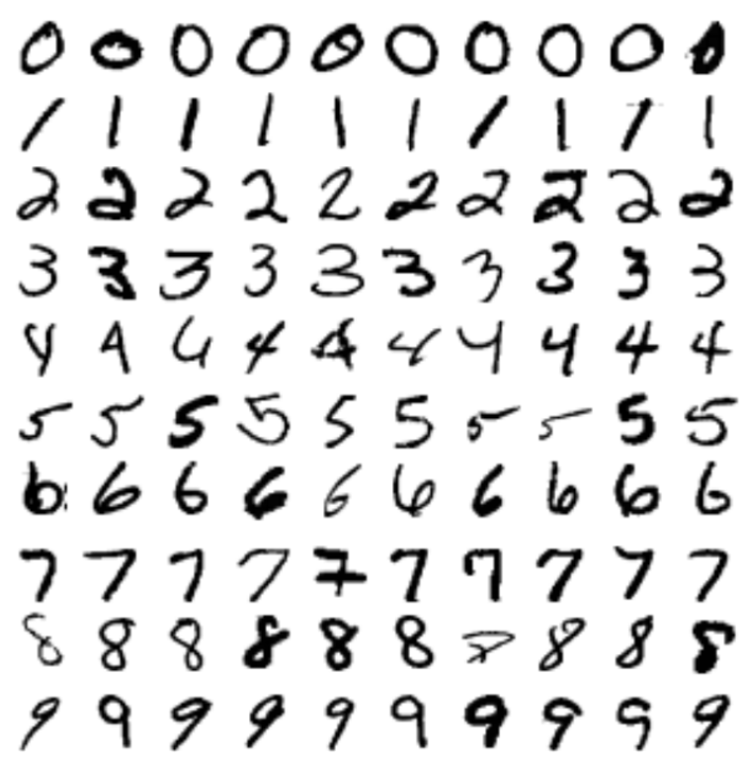
MNIST
Large labelled data set of hand written digits.
Easily loaded and utilized.

Slide 9
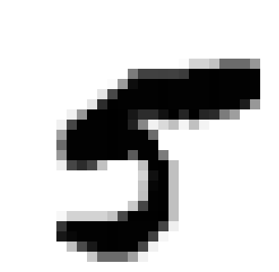
MNIST
Each handwritten digit was originally fitted to a 28x28 pixel image. This image could then be converted in a 784 long array to represent the image.
Digit array:
[0,0.00,0.00,0.00,0.00,0.00,0.00,0.00,0.00,0.00,0.00,0.00,0.00,0.00,0.00,0.00,0.00,0.00,0.00,0.00,0.00,0.00,0.00,0.00,0.00,0.00,0.00,0
0,0.00,0.00,0.00,0.00,0.00,0.00,0.00,0.00,0.00,0.00,0.00,0.00,0.00,0.00,0.00,0.00,0.00,0.00,0.00,0.00,0.00,0.00,0.00,0.00,0.00,0.00,0
0,0.00,0.00,0.00,0.00,0.00,0.00,0.00,0.00,0.00,0.00,0.00,0.00,0.00,0.00,0.00,0.00,0.00,0.00,0.00,0.00,0.00,0.00,0.00,0.00,0.00,0.00,0
0,0.00,0.00,0.00,0.00,0.00,0.00,0.00,0.00,0.00,0.00,0.00,0.00,0.00,0.00,0.00,0.00,0.00,0.00,0.00,0.00,0.00,0.00,0.00,0.00,0.00,0.00,0
0,0.00,0.00,0.00,0.00,0.00,0.00,0.00,0.00,0.00,0.00,0.00,0.00,0.00,0.00,0.00,0.00,0.00,0.00,0.00,0.00,0.00,0.00,0.00,0.00,0.00,0.00,0
0,0.00,0.00,0.00,0.00,0.00,0.00,0.00,0.00,0.00,0.00,0.00,0.00,0.00,0.00,0.00,0.00,0.00,0.00,0.00,0.00,0.00,0.00,0.00,0.00,0.00,0.00,0
0,0.00,0.00,0.00,0.00,0.00,0.00,0.00,0.00,0.00,0.00,0.00,0.00,0.00,0.00,0.00,0.00,0.00,0.02,0.17,0.17,0.24,0.58,0.58,0.58,0.41,0.00,0
0,0.00,0.00,0.00,0.00,0.00,0.00,0.00,0.00,0.00,0.00,0.00,0.00,0.51,0.75,0.75,0.75,0.75,0.76,0.99,0.99,0.99,0.99,0.99,0.99,0.99,0.00,0
0,0.00,0.00,0.00,0.00,0.00,0.00,0.00,0.00,0.00,0.00,0.02,0.40,0.95,0.99,0.99,0.99,0.99,0.99,0.99,0.99,0.99,0.99,0.99,0.99,0.99,0.00,0
0,0.00,0.00,0.00,0.00,0.00,0.00,0.00,0.00,0.00,0.11,0.72,0.99,0.99,0.99,0.99,0.99,0.99,0.99,0.99,0.99,0.99,0.99,0.99,0.99,0.99,0.00,0
0,0.00,0.00,0.00,0.00,0.00,0.00,0.00,0.00,0.11,0.83,0.99,0.99,0.99,0.99,0.99,0.99,0.99,0.99,0.99,0.99,0.99,0.99,0.99,0.89,0.40,0.00,0
0,0.00,0.00,0.00,0.00,0.00,0.00,0.06,0.41,0.99,0.99,1.00,0.99,0.91,0.83,0.83,0.93,0.99,0.85,0.99,0.85,0.83,0.51,0.38,0.00,0.00,0.00,0
0,0.00,0.00,0.00,0.00,0.00,0.06,0.73,0.99,0.99,0.99,0.99,0.99,0.87,0.47,0.05,0.15,0.25,0.04,0.25,0.04,0.00,0.00,0.00,0.00,0.00,0.00,0
0,0.00,0.00,0.00,0.00,0.00,0.38,0.99,0.99,0.99,0.99,0.99,0.99,0.99,0.99,0.58,0.00,0.00,0.00,0.00,0.00,0.00,0.00,0.00,0.00,0.00,0.00,0
0,0.00,0.00,0.00,0.00,0.00,0.58,0.99,0.99,0.99,0.99,0.99,0.99,0.99,0.99,0.99,0.00,0.00,0.00,0.00,0.00,0.00,0.00,0.00,0.00,0.00,0.00,0
0,0.00,0.00,0.00,0.00,0.00,0.41,0.99,0.99,0.99,0.99,0.99,0.99,0.64,0.99,0.99,0.52,0.00,0.00,0.00,0.00,0.00,0.00,0.00,0.00,0.00,0.00,0
0,0.00,0.00,0.00,0.00,0.00,0.07,0.73,0.83,0.73,0.24,0.00,0.00,0.00,0.25,0.99,1.00,0.25,0.00,0.00,0.00,0.00,0.00,0.00,0.00,0.00,0.00,0
0,0.00,0.00,0.00,0.00,0.00,0.00,0.00,0.00,0.00,0.00,0.00,0.00,0.00,0.17,0.94,0.99,0.25,0.00,0.00,0.00,0.00,0.00,0.00,0.00,0.00,0.00,0
0,0.00,0.00,0.00,0.00,0.00,0.00,0.00,0.00,0.00,0.00,0.00,0.00,0.00,0.23,0.98,0.99,0.25,0.00,0.00,0.00,0.00,0.00,0.00,0.00,0.00,0.00,0
0,0.00,0.00,0.00,0.00,0.00,0.00,0.00,0.00,0.00,0.00,0.00,0.00,0.00,0.25,0.25,0.99,0.99,0.25,0.00,0.00,0.00,0.00,0.00,0.00,0.00,0.00,0
0,0.00,0.00,0.00,0.00,0.00,0.00,0.00,0.00,0.00,0.00,0.00,0.00,0.00,0.21,0.21,0.73,0.99,0.99,0.25,0.00,0.00,0.00,0.00,0.00,0.00,0.00,0
0,0.00,0.00,0.00,0.00,0.00,0.00,0.00,0.03,0.17,0.17,0.17,0.17,0.24,0.72,0.99,0.99,0.99,1.00,0.25,0.00,0.00,0.00,0.00,0.00,0.00,0.00,0
0,0.00,0.00,0.00,0.00,0.00,0.00,0.00,0.79,0.99,0.99,0.99,0.99,0.99,0.99,0.99,0.99,0.99,0.73,0.06,0.00,0.00,0.00,0.00,0.00,0.00,0.00,0
0,0.00,0.00,0.00,0.00,0.00,0.00,0.00,0.91,0.97,0.99,0.99,0.99,0.99,0.99,0.99,0.99,0.75,0.04,0.00,0.00,0.00,0.00,0.00,0.00,0.00,0.00,0
0,0.00,0.00,0.00,0.00,0.00,0.00,0.00,0.00,0.25,0.71,0.91,0.99,0.99,0.99,0.99,0.72,0.05,0.00,0.00,0.00,0.00,0.00,0.00,0.00,0.00,0.00,0
0,0.00,0.00,0.00,0.00,0.00,0.00,0.00,0.00,0.00,0.00,0.22,0.58,0.58,0.58,0.37,0.05,0.00,0.00,0.00,0.00,0.00,0.00,0.00,0.00,0.00,0.00,0
0,0.00,0.00,0.00,0.00,0.00,0.00,0.00,0.00,0.00,0.00,0.00,0.00,0.00,0.00,0.00,0.00,0.00,0.00,0.00,0.00,0.00,0.00,0.00,0.00,0.00,0.00,0
0,0.00,0.00,0.00,0.00,0.00,0.00,0.00,0.00,0.00,0.00,0.00,0.00,0.00,0.00,0.00,0.00,0.00,0.00,0.00,0.00,0.00,0.00,0.00,0.00,0.00,0.00,0]

Slide 10
MNIST
Each handwritten digit was originally fitted to a 28x28 pixel image. This image could then be converted in a 784 long array to represent the image.
Digit array:
[0,0.00,0.00,0.00,0.00,0.00,0.00,0.00,0.00,0.00,0.00,0.00,0.00,0.00,0.00,0.00,0.00,0.00,0.00,0.00,0.00,0.00,0.00,0.00,0.00,0.00,0.00,0
0,0.00,0.00,0.00,0.00,0.00,0.00,0.00,0.00,0.00,0.00,0.00,0.00,0.00,0.00,0.00,0.00,0.00,0.00,0.00,0.00,0.00,0.00,0.00,0.00,0.00,0.00,0
0,0.00,0.00,0.00,0.00,0.00,0.00,0.00,0.00,0.00,0.00,0.00,0.00,0.00,0.00,0.00,0.00,0.00,0.00,0.00,0.00,0.00,0.00,0.00,0.00,0.00,0.00,0
0,0.00,0.00,0.00,0.00,0.00,0.00,0.00,0.00,0.00,0.00,0.00,0.00,0.00,0.00,0.00,0.00,0.00,0.00,0.00,0.00,0.00,0.00,0.00,0.00,0.00,0.00,0
0,0.00,0.00,0.00,0.00,0.00,0.00,0.00,0.00,0.00,0.00,0.00,0.00,0.00,0.00,0.00,0.00,0.00,0.00,0.00,0.00,0.00,0.00,0.00,0.00,0.00,0.00,0
0,0.00,0.00,0.00,0.00,0.00,0.00,0.00,0.00,0.00,0.00,0.00,0.00,0.00,0.00,0.00,0.00,0.00,0.00,0.00,0.00,0.00,0.00,0.00,0.00,0.00,0.00,0
0,0.00,0.00,0.00,0.00,0.00,0.00,0.00,0.00,0.00,0.00,0.00,0.00,0.00,0.00,0.00,0.00,0.00,0.02,0.17,0.17,0.24,0.58,0.58,0.58,0.41,0.00,0
0,0.00,0.00,0.00,0.00,0.00,0.00,0.00,0.00,0.00,0.00,0.00,0.00,0.51,0.75,0.75,0.75,0.75,0.76,0.99,0.99,0.99,0.99,0.99,0.99,0.99,0.00,0
0,0.00,0.00,0.00,0.00,0.00,0.00,0.00,0.00,0.00,0.00,0.02,0.40,0.95,0.99,0.99,0.99,0.99,0.99,0.99,0.99,0.99,0.99,0.99,0.99,0.99,0.00,0
0,0.00,0.00,0.00,0.00,0.00,0.00,0.00,0.00,0.00,0.11,0.72,0.99,0.99,0.99,0.99,0.99,0.99,0.99,0.99,0.99,0.99,0.99,0.99,0.99,0.99,0.00,0
0,0.00,0.00,0.00,0.00,0.00,0.00,0.00,0.00,0.11,0.83,0.99,0.99,0.99,0.99,0.99,0.99,0.99,0.99,0.99,0.99,0.99,0.99,0.99,0.89,0.40,0.00,0
0,0.00,0.00,0.00,0.00,0.00,0.00,0.06,0.41,0.99,0.99,1.00,0.99,0.91,0.83,0.83,0.93,0.99,0.85,0.99,0.85,0.83,0.51,0.38,0.00,0.00,0.00,0
0,0.00,0.00,0.00,0.00,0.00,0.06,0.73,0.99,0.99,0.99,0.99,0.99,0.87,0.47,0.05,0.15,0.25,0.04,0.25,0.04,0.00,0.00,0.00,0.00,0.00,0.00,0
0,0.00,0.00,0.00,0.00,0.00,0.38,0.99,0.99,0.99,0.99,0.99,0.99,0.99,0.99,0.58,0.00,0.00,0.00,0.00,0.00,0.00,0.00,0.00,0.00,0.00,0.00,0
0,0.00,0.00,0.00,0.00,0.00,0.58,0.99,0.99,0.99,0.99,0.99,0.99,0.99,0.99,0.99,0.00,0.00,0.00,0.00,0.00,0.00,0.00,0.00,0.00,0.00,0.00,0
0,0.00,0.00,0.00,0.00,0.00,0.41,0.99,0.99,0.99,0.99,0.99,0.99,0.64,0.99,0.99,0.52,0.00,0.00,0.00,0.00,0.00,0.00,0.00,0.00,0.00,0.00,0
0,0.00,0.00,0.00,0.00,0.00,0.07,0.73,0.83,0.73,0.24,0.00,0.00,0.00,0.25,0.99,1.00,0.25,0.00,0.00,0.00,0.00,0.00,0.00,0.00,0.00,0.00,0
0,0.00,0.00,0.00,0.00,0.00,0.00,0.00,0.00,0.00,0.00,0.00,0.00,0.00,0.17,0.94,0.99,0.25,0.00,0.00,0.00,0.00,0.00,0.00,0.00,0.00,0.00,0
0,0.00,0.00,0.00,0.00,0.00,0.00,0.00,0.00,0.00,0.00,0.00,0.00,0.00,0.23,0.98,0.99,0.25,0.00,0.00,0.00,0.00,0.00,0.00,0.00,0.00,0.00,0
0,0.00,0.00,0.00,0.00,0.00,0.00,0.00,0.00,0.00,0.00,0.00,0.00,0.00,0.25,0.25,0.99,0.99,0.25,0.00,0.00,0.00,0.00,0.00,0.00,0.00,0.00,0
0,0.00,0.00,0.00,0.00,0.00,0.00,0.00,0.00,0.00,0.00,0.00,0.00,0.00,0.21,0.21,0.73,0.99,0.99,0.25,0.00,0.00,0.00,0.00,0.00,0.00,0.00,0
0,0.00,0.00,0.00,0.00,0.00,0.00,0.00,0.03,0.17,0.17,0.17,0.17,0.24,0.72,0.99,0.99,0.99,1.00,0.25,0.00,0.00,0.00,0.00,0.00,0.00,0.00,0
0,0.00,0.00,0.00,0.00,0.00,0.00,0.00,0.79,0.99,0.99,0.99,0.99,0.99,0.99,0.99,0.99,0.99,0.73,0.06,0.00,0.00,0.00,0.00,0.00,0.00,0.00,0
0,0.00,0.00,0.00,0.00,0.00,0.00,0.00,0.91,0.97,0.99,0.99,0.99,0.99,0.99,0.99,0.99,0.75,0.04,0.00,0.00,0.00,0.00,0.00,0.00,0.00,0.00,0
0,0.00,0.00,0.00,0.00,0.00,0.00,0.00,0.00,0.25,0.71,0.91,0.99,0.99,0.99,0.99,0.72,0.05,0.00,0.00,0.00,0.00,0.00,0.00,0.00,0.00,0.00,0
0,0.00,0.00,0.00,0.00,0.00,0.00,0.00,0.00,0.00,0.00,0.22,0.58,0.58,0.58,0.37,0.05,0.00,0.00,0.00,0.00,0.00,0.00,0.00,0.00,0.00,0.00,0
0,0.00,0.00,0.00,0.00,0.00,0.00,0.00,0.00,0.00,0.00,0.00,0.00,0.00,0.00,0.00,0.00,0.00,0.00,0.00,0.00,0.00,0.00,0.00,0.00,0.00,0.00,0
0,0.00,0.00,0.00,0.00,0.00,0.00,0.00,0.00,0.00,0.00,0.00,0.00,0.00,0.00,0.00,0.00,0.00,0.00,0.00,0.00,0.00,0.00,0.00,0.00,0.00,0.00,0]

Slide 11
MNIST
Each handwritten digit was originally fitted to a 28x28 pixel image. This image could then be converted in a 784 long array to represent the image.
Digit array:
[0,0.00,0.00,0.00,0.00,0.00,0.00,0.00,0.00,0.00,0.00,0.00,0.00,0.00,0.00,0.00,0.00,0.00,0.00,0.00,0.00,0.00,0.00,0.00,0.00,0.00,0.00,0
0,0.00,0.00,0.00,0.00,0.00,0.00,0.00,0.00,0.00,0.00,0.00,0.00,0.00,0.00,0.00,0.00,0.00,0.00,0.00,0.00,0.00,0.00,0.00,0.00,0.00,0.00,0
0,0.00,0.00,0.00,0.00,0.00,0.00,0.00,0.00,0.00,0.00,0.00,0.00,0.00,0.00,0.00,0.00,0.00,0.00,0.00,0.00,0.00,0.00,0.00,0.00,0.00,0.00,0
0,0.00,0.00,0.00,0.00,0.00,0.00,0.00,0.00,0.00,0.00,0.00,0.00,0.00,0.00,0.00,0.00,0.00,0.00,0.00,0.00,0.00,0.00,0.00,0.00,0.00,0.00,0
0,0.00,0.00,0.00,0.00,0.00,0.00,0.00,0.00,0.00,0.00,0.00,0.00,0.00,0.00,0.00,0.00,0.00,0.00,0.00,0.00,0.00,0.00,0.00,0.00,0.00,0.00,0
0,0.00,0.00,0.00,0.00,0.00,0.00,0.00,0.00,0.00,0.00,0.00,0.00,0.00,0.00,0.00,0.00,0.00,0.00,0.00,0.00,0.00,0.00,0.00,0.00,0.00,0.00,0
0,0.00,0.00,0.00,0.00,0.00,0.00,0.00,0.00,0.00,0.00,0.00,0.00,0.00,0.00,0.00,0.00,0.00,0.02,0.17,0.17,0.24,0.58,0.58,0.58,0.41,0.00,0
0,0.00,0.00,0.00,0.00,0.00,0.00,0.00,0.00,0.00,0.00,0.00,0.00,0.51,0.75,0.75,0.75,0.75,0.76,0.99,0.99,0.99,0.99,0.99,0.99,0.99,0.00,0
0,0.00,0.00,0.00,0.00,0.00,0.00,0.00,0.00,0.00,0.00,0.02,0.40,0.95,0.99,0.99,0.99,0.99,0.99,0.99,0.99,0.99,0.99,0.99,0.99,0.99,0.00,0
0,0.00,0.00,0.00,0.00,0.00,0.00,0.00,0.00,0.00,0.11,0.72,0.99,0.99,0.99,0.99,0.99,0.99,0.99,0.99,0.99,0.99,0.99,0.99,0.99,0.99,0.00,0
0,0.00,0.00,0.00,0.00,0.00,0.00,0.00,0.00,0.11,0.83,0.99,0.99,0.99,0.99,0.99,0.99,0.99,0.99,0.99,0.99,0.99,0.99,0.99,0.89,0.40,0.00,0
0,0.00,0.00,0.00,0.00,0.00,0.00,0.06,0.41,0.99,0.99,1.00,0.99,0.91,0.83,0.83,0.93,0.99,0.85,0.99,0.85,0.83,0.51,0.38,0.00,0.00,0.00,0
0,0.00,0.00,0.00,0.00,0.00,0.06,0.73,0.99,0.99,0.99,0.99,0.99,0.87,0.47,0.05,0.15,0.25,0.04,0.25,0.04,0.00,0.00,0.00,0.00,0.00,0.00,0
0,0.00,0.00,0.00,0.00,0.00,0.38,0.99,0.99,0.99,0.99,0.99,0.99,0.99,0.99,0.58,0.00,0.00,0.00,0.00,0.00,0.00,0.00,0.00,0.00,0.00,0.00,0
0,0.00,0.00,0.00,0.00,0.00,0.58,0.99,0.99,0.99,0.99,0.99,0.99,0.99,0.99,0.99,0.00,0.00,0.00,0.00,0.00,0.00,0.00,0.00,0.00,0.00,0.00,0
0,0.00,0.00,0.00,0.00,0.00,0.41,0.99,0.99,0.99,0.99,0.99,0.99,0.64,0.99,0.99,0.52,0.00,0.00,0.00,0.00,0.00,0.00,0.00,0.00,0.00,0.00,0
0,0.00,0.00,0.00,0.00,0.00,0.07,0.73,0.83,0.73,0.24,0.00,0.00,0.00,0.25,0.99,1.00,0.25,0.00,0.00,0.00,0.00,0.00,0.00,0.00,0.00,0.00,0
0,0.00,0.00,0.00,0.00,0.00,0.00,0.00,0.00,0.00,0.00,0.00,0.00,0.00,0.17,0.94,0.99,0.25,0.00,0.00,0.00,0.00,0.00,0.00,0.00,0.00,0.00,0
0,0.00,0.00,0.00,0.00,0.00,0.00,0.00,0.00,0.00,0.00,0.00,0.00,0.00,0.23,0.98,0.99,0.25,0.00,0.00,0.00,0.00,0.00,0.00,0.00,0.00,0.00,0
0,0.00,0.00,0.00,0.00,0.00,0.00,0.00,0.00,0.00,0.00,0.00,0.00,0.00,0.25,0.25,0.99,0.99,0.25,0.00,0.00,0.00,0.00,0.00,0.00,0.00,0.00,0
0,0.00,0.00,0.00,0.00,0.00,0.00,0.00,0.00,0.00,0.00,0.00,0.00,0.00,0.21,0.21,0.73,0.99,0.99,0.25,0.00,0.00,0.00,0.00,0.00,0.00,0.00,0
0,0.00,0.00,0.00,0.00,0.00,0.00,0.00,0.03,0.17,0.17,0.17,0.17,0.24,0.72,0.99,0.99,0.99,1.00,0.25,0.00,0.00,0.00,0.00,0.00,0.00,0.00,0
0,0.00,0.00,0.00,0.00,0.00,0.00,0.00,0.79,0.99,0.99,0.99,0.99,0.99,0.99,0.99,0.99,0.99,0.73,0.06,0.00,0.00,0.00,0.00,0.00,0.00,0.00,0
0,0.00,0.00,0.00,0.00,0.00,0.00,0.00,0.91,0.97,0.99,0.99,0.99,0.99,0.99,0.99,0.99,0.75,0.04,0.00,0.00,0.00,0.00,0.00,0.00,0.00,0.00,0
0,0.00,0.00,0.00,0.00,0.00,0.00,0.00,0.00,0.25,0.71,0.91,0.99,0.99,0.99,0.99,0.72,0.05,0.00,0.00,0.00,0.00,0.00,0.00,0.00,0.00,0.00,0
0,0.00,0.00,0.00,0.00,0.00,0.00,0.00,0.00,0.00,0.00,0.22,0.58,0.58,0.58,0.37,0.05,0.00,0.00,0.00,0.00,0.00,0.00,0.00,0.00,0.00,0.00,0
0,0.00,0.00,0.00,0.00,0.00,0.00,0.00,0.00,0.00,0.00,0.00,0.00,0.00,0.00,0.00,0.00,0.00,0.00,0.00,0.00,0.00,0.00,0.00,0.00,0.00,0.00,0
0,0.00,0.00,0.00,0.00,0.00,0.00,0.00,0.00,0.00,0.00,0.00,0.00,0.00,0.00,0.00,0.00,0.00,0.00,0.00,0.00,0.00,0.00,0.00,0.00,0.00,0.00,0]

Slide 12
MNIST
Each image was then manually labeled from 0 – 9. This label is represented as a ten item long array of nine 0’s and one 1. The position of the 1 indicates the digit;
0 - [1, 0, 0, 0, 0, 0, 0, 0, 0, 0]
1 - [0, 1, 0, 0, 0, 0, 0, 0, 0, 0]
2 - [0, 0, 1, 0, 0, 0, 0, 0, 0, 0]
3 - [0, 0, 0, 1, 0, 0, 0, 0, 0, 0]
4 - [0, 0, 0, 0, 1, 0, 0, 0, 0, 0]
5 - [0, 0, 0, 0, 0, 1, 0, 0, 0, 0]
6 - [0, 0, 0, 0, 0, 0, 1, 0, 0, 0]
7 - [0, 0, 0, 0, 0, 0, 0, 1, 0, 0]
8 - [0, 0, 0, 0, 0, 0, 0, 0, 1, 0]
9 - [0, 0, 0, 0, 0, 0, 0, 0, 0, 1]

Slide 13
MNIST
Each image was then manually labeled from 0 – 9. This label is represented as a ten item long array of nine 0’s and one 1. The position of the 1 indicates the digit;
0 - [1, 0, 0, 0, 0, 0, 0, 0, 0, 0]
1 - [0, 1, 0, 0, 0, 0, 0, 0, 0, 0]
2 - [0, 0, 1, 0, 0, 0, 0, 0, 0, 0]
3 - [0, 0, 0, 1, 0, 0, 0, 0, 0, 0]
4 - [0, 0, 0, 0, 1, 0, 0, 0, 0, 0]
5 - [0, 0, 0, 0, 0, 1, 0, 0, 0, 0]
6 - [0, 0, 0, 0, 0, 0, 1, 0, 0, 0]
7 - [0, 0, 0, 0, 0, 0, 0, 1, 0, 0]
8 - [0, 0, 0, 0, 0, 0, 0, 0, 1, 0]
9 - [0, 0, 0, 0, 0, 0, 0, 0, 0, 1]

Slide 14
MNIST
Each image was then manually labeled from 0 – 9. This label is represented as a ten item long array of nine 0’s and one 1. The position of the 1 indicates the digit;
0 - [1, 0, 0, 0, 0, 0, 0, 0, 0, 0]
1 - [0, 1, 0, 0, 0, 0, 0, 0, 0, 0]
2 - [0, 0, 1, 0, 0, 0, 0, 0, 0, 0]
3 - [0, 0, 0, 1, 0, 0, 0, 0, 0, 0]
4 - [0, 0, 0, 0, 1, 0, 0, 0, 0, 0]
5 - [0, 0, 0, 0, 0, 1, 0, 0, 0, 0]
6 - [0, 0, 0, 0, 0, 0, 1, 0, 0, 0]
7 - [0, 0, 0, 0, 0, 0, 0, 1, 0, 0]
8 - [0, 0, 0, 0, 0, 0, 0, 0, 1, 0]
9 - [0, 0, 0, 0, 0, 0, 0, 0, 0, 1]
We shall see shortly why this label format is useful.

Slide 15
MNIST
Digit array:
[0,0.00,0.00,0.00,0.00,0.00,0.00,0.00,0.00,0.00,0.00,0.00,0.00,0.00,0.00,0.00,0.00,0.00,0.00,0.00,0.00,0.00,0.00,0.00,0.00,0.00,0.00,0
0,0.00,0.00,0.00,0.00,0.00,0.00,0.00,0.00,0.00,0.00,0.00,0.00,0.00,0.00,0.00,0.00,0.00,0.00,0.00,0.00,0.00,0.00,0.00,0.00,0.00,0.00,0
0,0.00,0.00,0.00,0.00,0.00,0.00,0.00,0.00,0.00,0.00,0.00,0.00,0.00,0.00,0.00,0.00,0.00,0.00,0.00,0.00,0.00,0.00,0.00,0.00,0.00,0.00,0
0,0.00,0.00,0.00,0.00,0.00,0.00,0.00,0.00,0.00,0.00,0.00,0.00,0.00,0.00,0.00,0.00,0.00,0.00,0.00,0.00,0.00,0.00,0.00,0.00,0.00,0.00,0
0,0.00,0.00,0.00,0.00,0.00,0.00,0.00,0.00,0.00,0.00,0.00,0.00,0.00,0.00,0.00,0.00,0.00,0.00,0.00,0.00,0.00,0.00,0.00,0.00,0.00,0.00,0
0,0.00,0.00,0.00,0.00,0.00,0.00,0.00,0.00,0.00,0.00,0.00,0.00,0.00,0.00,0.00,0.00,0.00,0.00,0.00,0.00,0.00,0.00,0.00,0.00,0.00,0.00,0
0,0.00,0.00,0.00,0.00,0.00,0.00,0.00,0.00,0.00,0.00,0.00,0.00,0.00,0.00,0.00,0.00,0.00,0.02,0.17,0.17,0.24,0.58,0.58,0.58,0.41,0.00,0
0,0.00,0.00,0.00,0.00,0.00,0.00,0.00,0.00,0.00,0.00,0.00,0.00,0.51,0.75,0.75,0.75,0.75,0.76,0.99,0.99,0.99,0.99,0.99,0.99,0.99,0.00,0
0,0.00,0.00,0.00,0.00,0.00,0.00,0.00,0.00,0.00,0.00,0.02,0.40,0.95,0.99,0.99,0.99,0.99,0.99,0.99,0.99,0.99,0.99,0.99,0.99,0.99,0.00,0
0,0.00,0.00,0.00,0.00,0.00,0.00,0.00,0.00,0.00,0.11,0.72,0.99,0.99,0.99,0.99,0.99,0.99,0.99,0.99,0.99,0.99,0.99,0.99,0.99,0.99,0.00,0
0,0.00,0.00,0.00,0.00,0.00,0.00,0.00,0.00,0.11,0.83,0.99,0.99,0.99,0.99,0.99,0.99,0.99,0.99,0.99,0.99,0.99,0.99,0.99,0.89,0.40,0.00,0
0,0.00,0.00,0.00,0.00,0.00,0.00,0.06,0.41,0.99,0.99,1.00,0.99,0.91,0.83,0.83,0.93,0.99,0.85,0.99,0.85,0.83,0.51,0.38,0.00,0.00,0.00,0
0,0.00,0.00,0.00,0.00,0.00,0.06,0.73,0.99,0.99,0.99,0.99,0.99,0.87,0.47,0.05,0.15,0.25,0.04,0.25,0.04,0.00,0.00,0.00,0.00,0.00,0.00,0
0,0.00,0.00,0.00,0.00,0.00,0.38,0.99,0.99,0.99,0.99,0.99,0.99,0.99,0.99,0.58,0.00,0.00,0.00,0.00,0.00,0.00,0.00,0.00,0.00,0.00,0.00,0
0,0.00,0.00,0.00,0.00,0.00,0.58,0.99,0.99,0.99,0.99,0.99,0.99,0.99,0.99,0.99,0.00,0.00,0.00,0.00,0.00,0.00,0.00,0.00,0.00,0.00,0.00,0
0,0.00,0.00,0.00,0.00,0.00,0.41,0.99,0.99,0.99,0.99,0.99,0.99,0.64,0.99,0.99,0.52,0.00,0.00,0.00,0.00,0.00,0.00,0.00,0.00,0.00,0.00,0
0,0.00,0.00,0.00,0.00,0.00,0.07,0.73,0.83,0.73,0.24,0.00,0.00,0.00,0.25,0.99,1.00,0.25,0.00,0.00,0.00,0.00,0.00,0.00,0.00,0.00,0.00,0
0,0.00,0.00,0.00,0.00,0.00,0.00,0.00,0.00,0.00,0.00,0.00,0.00,0.00,0.17,0.94,0.99,0.25,0.00,0.00,0.00,0.00,0.00,0.00,0.00,0.00,0.00,0
0,0.00,0.00,0.00,0.00,0.00,0.00,0.00,0.00,0.00,0.00,0.00,0.00,0.00,0.23,0.98,0.99,0.25,0.00,0.00,0.00,0.00,0.00,0.00,0.00,0.00,0.00,0
0,0.00,0.00,0.00,0.00,0.00,0.00,0.00,0.00,0.00,0.00,0.00,0.00,0.00,0.25,0.25,0.99,0.99,0.25,0.00,0.00,0.00,0.00,0.00,0.00,0.00,0.00,0
0,0.00,0.00,0.00,0.00,0.00,0.00,0.00,0.00,0.00,0.00,0.00,0.00,0.00,0.21,0.21,0.73,0.99,0.99,0.25,0.00,0.00,0.00,0.00,0.00,0.00,0.00,0
0,0.00,0.00,0.00,0.00,0.00,0.00,0.00,0.03,0.17,0.17,0.17,0.17,0.24,0.72,0.99,0.99,0.99,1.00,0.25,0.00,0.00,0.00,0.00,0.00,0.00,0.00,0
0,0.00,0.00,0.00,0.00,0.00,0.00,0.00,0.79,0.99,0.99,0.99,0.99,0.99,0.99,0.99,0.99,0.99,0.73,0.06,0.00,0.00,0.00,0.00,0.00,0.00,0.00,0
0,0.00,0.00,0.00,0.00,0.00,0.00,0.00,0.91,0.97,0.99,0.99,0.99,0.99,0.99,0.99,0.99,0.75,0.04,0.00,0.00,0.00,0.00,0.00,0.00,0.00,0.00,0
0,0.00,0.00,0.00,0.00,0.00,0.00,0.00,0.00,0.25,0.71,0.91,0.99,0.99,0.99,0.99,0.72,0.05,0.00,0.00,0.00,0.00,0.00,0.00,0.00,0.00,0.00,0
0,0.00,0.00,0.00,0.00,0.00,0.00,0.00,0.00,0.00,0.00,0.22,0.58,0.58,0.58,0.37,0.05,0.00,0.00,0.00,0.00,0.00,0.00,0.00,0.00,0.00,0.00,0
0,0.00,0.00,0.00,0.00,0.00,0.00,0.00,0.00,0.00,0.00,0.00,0.00,0.00,0.00,0.00,0.00,0.00,0.00,0.00,0.00,0.00,0.00,0.00,0.00,0.00,0.00,0
0,0.00,0.00,0.00,0.00,0.00,0.00,0.00,0.00,0.00,0.00,0.00,0.00,0.00,0.00,0.00,0.00,0.00,0.00,0.00,0.00,0.00,0.00,0.00,0.00,0.00,0.00,0]
Label array:
[ 0.0, 0.00, 0.00, 0.00, 0.00, 1.00, 0.00, 0.00, 0.00, 0.00]
Notes:
From here switch to using the code

Slide 16
MNIST
Turning real-world data into a form usable by algorithms is an important part of Machine Learning.
This is called data preprocessing.
MNIST dataset has already had all this done for us, so is a good place to start for us beginners.
Notes:
From here switch to using the code

Slide 17
The fun stuff. Tutorial code can be found in the following repository: https://github.com/CapgeminiTechHub/Tensorflow

Slide 18
Run ‘mnist_tutorial_data.py’ Code to import the data. Lines 1-42 And to visualize the data. Lines 43-123

Slide 19
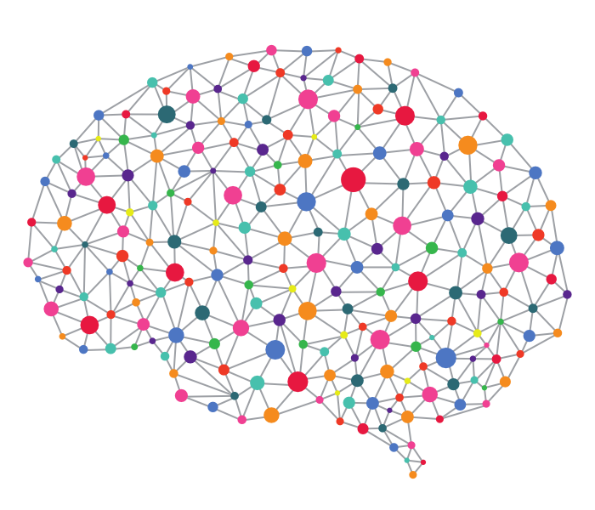
Artificial Neural Networks
An area of AI/Machine learning inspired by natural intelligence.
ANNs are at their heart a mathematical model of a biological neural network.
Notes:
Note: not “model of brain”, we are a far way off that and this is still fairly simplistic.

Slide 20
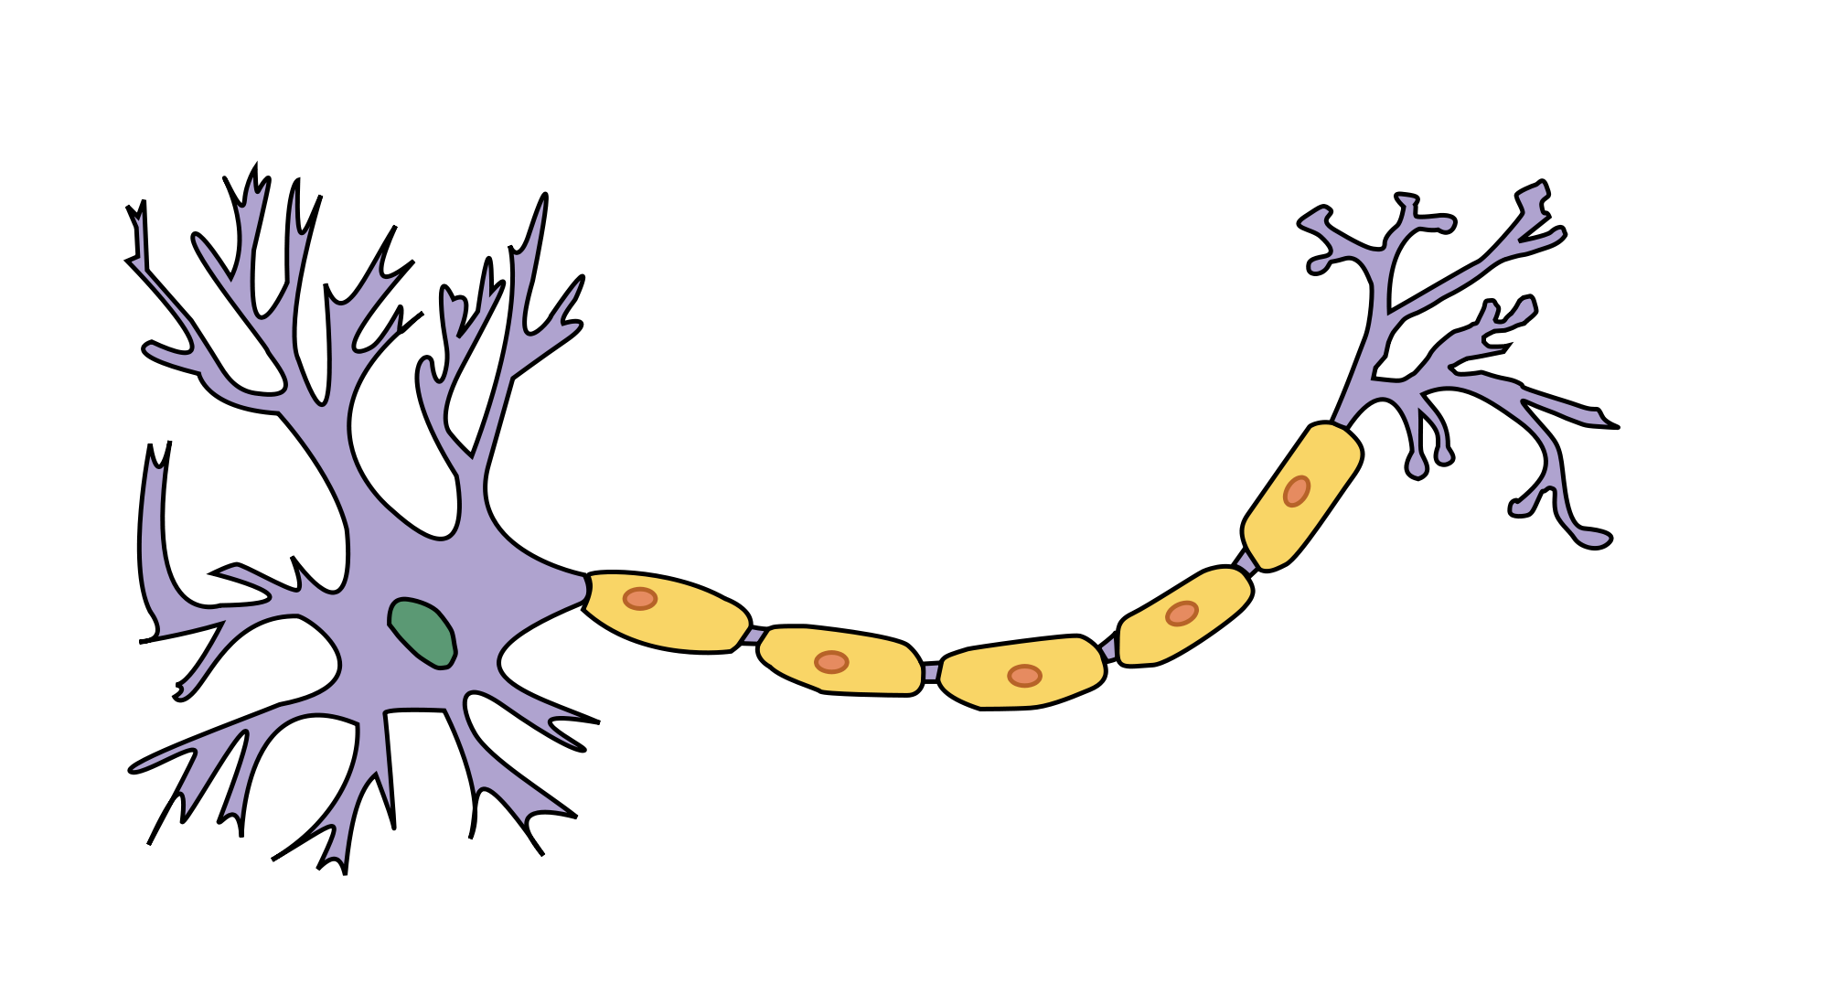
Biological Neuron
A single cell.
Uses chemical gradients to send an ‘Action Potential’, i.e. a signal, down its stem.
All or Nothing: it will only fire it receives enough stimulus to do so, otherwise it is inactive.

Slide 21
Biological Nervous System
A network of Neurons.
A signal is propagated through the network using neurotransmitters.
Key points: A feed-forward network of discreet On/Off units.
NT
NT
NT
NT
NT
NT
NT
Notes:
Feed-forward: the state of one unit is dependent on the state of the ones before it.

Slide 22
Artificial Neuron - Perceptron
A Neuron can be very simply represented by a mathematical function, that will only fire (produce an output between 0-1) if the total input exceeds a threshold.
This function is often called the Step Function or Activation function.
S
Input
Input
Output (0-1)
Input

Slide 23
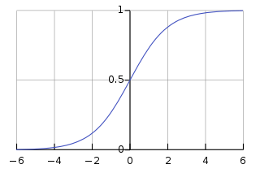
Artificial Neuron - Perceptron
A Neuron can be very simply represented by a mathematical function, that will only fire (produce an output between 0-1) if the total input exceeds a threshold.
This function is often called the Step Function or Activation function.
We will be using a function called the Sigmoid function.
Input
Input
Output (0-1)
Input
Notes:
The graph shows an example activation function, the Sigmoid function.
See how no matter what the input, the output is between 0-1
Now lets create a network.

Slide 24
Artificial Neuron - Perceptron
There is a concept in ANN’s called the bias.
It can be thought of as a ‘threshold’ – it makes certain perceptrons harder to fire than others.
Input
Input
Output (0-1)
Bias

Slide 25
Artificial Neuron - Perceptron
There is a concept in ANN’s called the bias.
It can be thought of as a ‘threshold’ – it makes certain perceptrons harder to fire than others.
However in this tutorial we don’t actually need them, so for simplicity’s sake we will forget about it for now.
Input
Input
Output (0-1)
Bias
Notes:
The bias is very important in ANNs
But for our purposes would make it unnecessarily complex – we can get decent accuracy without them.
Bias’s can be seen as additional weights, so they’re not really anything new or different. But to explain that I’d need to get more complex, just to bring us back to our current understanding.

Slide 26
Artificial Neuron - Perceptron
So let’s use these to make a network.
Input
Input
Output (0-1)
Input
Notes:
Now lets create a network.

Slide 27
Artificial Neural Networks
We can now create a network of these individual perceptrons to form an Artificial Neural Network.
Each arrow represents the output of the left Perceptron being piped to the next Perceptron as one of its inputs.
S
S
In
S
S
Output
S
S
In
S
S
Output
S
S
In
S
S
Output
S
S
In
S
S
Output
S
S
In
S
S
Output
S
S

Slide 28
Artificial Neural Networks
We can now form a network of these individual perceptrons to form an Artificial Neural Network.
Each arrow represents the output of the left Perceptron being piped to the next Perceptron as one of its inputs.
These arrows are weighted, so some Perceptron to Perceptron links are more important then others.
S
S
In
S
S
Output
S
S
In
S
S
Output
S
S
In
S
S
Output
S
S
In
S
S
Output
S
S
In
S
S
Output
S
S
Notes:
These weightings are what changes during the learning process.
The changing weights allow a single generic network, to transform into multiple, specific, networks.

Slide 29
Artificial Neural Networks
We can now form a network of these individual perceptrons to form an Artificial Neural Network.
Each arrow represents the output of the left Perceptron being piped to the next Perceptron as one of its inputs.
These arrows are weighted, so some Perceptron to Perceptron links are more important then others.
S
S
In
S
S
Output
S
S
In
S
S
Output
S
S
In
S
S
Output
S
S
In
S
S
Output
S
S
In
S
S
Output
S
S
Notes:
These weightings are what changes during the learning process.
The changing weights allow a single generic network, to transform into multiple, specific, networks.
----------
So this is a basic network, but how exactly does this work?
You can think of it as one pattern of inputs, causes a certain in the first layer, that causes another pattern in the next

Slide 30
Artificial Neural Networks
S
S
How it works:
A certain pattern of inputs, causes a pattern in the first layer.
S
S
In
Output
S
S
In
S
S
Output
S
S
In
S
S
Output
S
S
In
S
S
Output
S
S
In
S
S
Output
S
S
Notes:
You can think of it as one pattern of inputs, causes a certain pattern in the first layer

Slide 31
Artificial Neural Networks
S
S
How it works:
A certain pattern of inputs, causes a pattern in the first layer.
That propagates forward and creates a pattern in the next layer
S
S
In
Output
S
S
In
S
S
Output
S
S
In
S
S
Output
S
S
In
S
S
Output
S
S
In
S
S
Output
S
S
Notes:
that causes another pattern in the next

Slide 32
Artificial Neural Networks
S
S
How it works:
A certain pattern of inputs, causes a pattern in the first layer.
That propagates forward and creates a pattern in the next layer.
And so on…
S
S
In
Output
S
S
In
S
S
Output
S
S
In
S
S
Output
S
S
In
S
S
Output
S
S
In
S
S
Output
S
S
Notes:
And so on

Slide 33
Artificial Neural Networks
S
S
How it works:
A certain pattern of inputs, causes a pattern in the first layer.
That propagates forward and creates a pattern in the next layer.
And so on, until an output is generated.
S
S
In
Output
S
S
In
S
S
Output
S
S
In
S
S
Output
S
S
In
S
S
Output
S
S
In
S
S
Output
S
S
Notes:
Until an out put is decided
Note: This is for a classification problem. For more complex problems the perceptrons aren’t simply on/off but instead the numerical value between 0 and 1 is important.

Slide 34
Artificial Neural Networks
S
S
In
S
S
Output
S
S
In
S
S
Output
A different input pattern, will result in a different output.
S
S
In
S
S
Output
S
S
In
S
S
Output
S
S
In
S
S
Output
S
S
Notes:
A different input pattern will result in a different output

Slide 35
Artificial Neural Networks
S
S
In
S
S
Output
S
S
In
S
S
Output
A different input pattern, will result in a different output.
S
S
In
S
S
Output
S
S
In
S
S
Output
S
S
In
S
S
Output
S
S
Notes:
A different input pattern will result in a different output

Slide 36
Artificial Neural Networks
S
S
In
S
S
Output
S
S
In
S
S
Output
A different input pattern, will result in a different output.
S
S
In
S
S
Output
S
S
In
S
S
Output
S
S
In
S
S
Output
S
S
Notes:
A different input pattern will result in a different output

Slide 37
Artificial Neural Networks
S
S
In
S
S
Output
S
S
In
S
S
Output
A different input pattern, will result in a different output.
S
S
In
S
S
Output
S
S
In
S
S
Output
S
S
In
S
S
Output
S
S
Notes:
A different input pattern will result in a different output
______________
This network however is more complicated then we need…

Slide 38
Artificial Neural Networks
The variables that define the model (number of hidden layers, nodes in each layer, starting weight and bias values, e.t.c) are called hyperparameters.
Often your first attempt at a model does not work as well as expected, and these hyperparameters need to be tuned to create a good architecture.
S
S
In
S
S
Output
S
S
In
S
S
Output
S
S
In
S
S
Output
S
S
In
S
S
Output
S
S
In
S
S
Output
S
S

Slide 39
MNIST Network
S
Output
S
Output
We can actually use a fairly simple network to train on the MNIST dataset.
We only need a single layer of 10 perceptrons to create a predictive model.
These perceptrons use a particular type of activation function called the Sigmoid Function
In₁
S
Output
S
Output
In₁
S
Output
In₃
S
Output
.
.
.
S
Output
Output
S
Output
In₇₈₄
S
Output
Input
S
Output
Notes:
Note: the 784 inputs are the pixels of the 28x28 picture in array form, as we saw earlier on.
Those ten individual perceptrons/step functions can be consolidated into a single function.

Slide 40

MNIST Network
S₀
Output
S₁
Output
In₁
S₂
Output
This single Sigmoid layer gives 10 outputs between 0 and 1.
S₃
Output
In₁
S₄
Output
In₃
S₅
Output
.
.
.
S₆
Output
S₇
Output
In₇₈₄
S₈
Output
S₉
Output
INPUTS
WEIGHTS
Sigmoid
Perceptrons
OUTPUT

Slide 41
MNIST Network
S₀
P(0)
S₁
P(1)
In₁
S₂
P(2)
This single Sigmoid layer gives 10 outputs between 0 and 1.
Each output can be interpreted as a probability, with 1 being the highest (100% certainty that it is that digit).
So in this example P(5) should be the highest output.
S₃
P(3)
In₁
S₄
P(4)
In₃
S₅
P(5)
.
.
.
S₆
P(6)
S₇
P(7)
In₇₈₄
S₈
P(8)
S₉
P(9)
INPUTS
WEIGHTS
Sigmoid
Perceptrons
OUTPUT

Slide 42
MNIST Network
S₀
0.01
S₁
0.15
In₁
S₂
0.20
This single Sigmoid layer gives 10 outputs between 0 and 1.
Each output can be interpreted as a probability, with 1 being the highest (100% certainty that it is that digit).
So in this example P(5) should be the highest output.
S₃
0.29
In₁
S₄
0.12
In₃
S₅
0.81
.
.
.
S₆
0.72
S₇
0.35
In₇₈₄
S₈
0.41
S₉
0.33
INPUTS
WEIGHTS
Sigmoid
Perceptrons
OUTPUT

Slide 43
MNIST Network
S₀
0.01
0
S₁
0.15
0
In₁
S₂
0.20
0
S₃
0.29
0
In₁
We can see now why the label format is so useful.
It allows direct comparison between the model output and the label.
S₄
0.12
0
In₃
S₅
0.81
1
.
.
.
S₆
0.72
0
S₇
0.35
0
In₇₈₄
S₈
0
0.41
S₉
0.33
0
INPUTS
WEIGHTS
Sigmoid
Perceptrons
OUTPUT
LABEL
Notes:
We saw earlier how we can see how a multilayer network would allow different output with different inputs, but how does this one work?

Slide 44
Open ‘mnist_tutorial_model.py’ Coding the model. Lines 124-146 Running the model. Lines 147-166

Slide 45
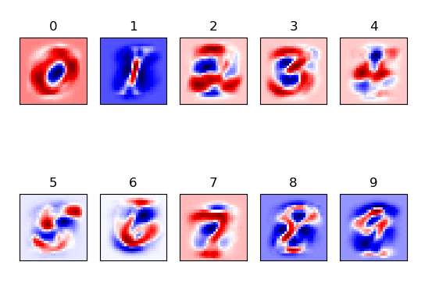
MNIST Network Visualising Weights
S₀
P(0)
S₁
P(1)
In₁
S₂
P(2)
S₃
P(3)
In₁
S₄
P(4)
In₃
S₅
P(5)
.
.
.
S₆
P(6)
S₇
P(7)
In₇₈₄
S₈
P(8)
S₉
P(9)

Slide 46
MNIST Network How it works
S₀
P(0)
S₁
P(1)
S₂
P(2)
S₃
P(3)
S₄
P(4)
Each Pixel will map to each Sigmoid Perceptron.
This diagram shows just three pixels’ mappings.
S₅
P(5)
S₆
P(6)
S₇
P(7)
S₈
P(8)
S₉
P(9)

Slide 47
MNIST Network How it works
S₀
P(0)
S₁
P(1)
S₂
P(2)
S₃
P(3)
S₄
P(4)
We can further simplify this down to show the three pixels just mapping with the Sigmoid Perceptron representing the probability the image is a 5.
S₅
P(5)
S₆
P(6)
S₇
P(7)
S₈
P(8)
S₉
P(9)

Slide 48
MNIST Network How it works
S₀
P(0)
S₁
P(1)
S₂
P(2)
S₃
P(3)
S₄
P(4)
S₅
P(5)
Lets looks at how each of these links should behave.
S₆
P(6)
S₇
P(7)
S₈
P(8)
S₉
P(9)

Slide 49
MNIST Network How it works
S₀
P(0)
S₁
P(1)
S₂
P(2)
S₃
P(3)
S₄
P(4)
If this pixel is dark, it suggests the image is a 5.
So the weighting should be positive, to push the sigmoid function towards 1.
S₅
P(5)
S₆
P(6)
S₇
P(7)
S₈
P(8)
S₉
P(9)

Slide 50
MNIST Network How it works
S₀
P(0)
S₁
P(1)
S₂
P(2)
S₃
P(3)
S₄
P(4)
If this pixel is dark, it suggests the image is not a 5.
So the weighting should be negative, to push the sigmoid function towards 0.
S₅
P(5)
S₆
P(6)
S₇
P(7)
S₈
P(8)
S₉
P(9)

Slide 51
MNIST Network How it works
S₀
P(0)
S₁
P(1)
S₂
P(2)
S₃
P(3)
S₄
P(4)
This pixel is very dependant on how you draw the 5.
So it’s value shouldn’t really have too much impact one way or another, so the weighting of this link should be small.
S₅
P(5)
S₆
P(6)
S₇
P(7)
S₈
P(8)
S₉
P(9)
Notes:
By small I mean around 0 – neither strongly positive nor negative.

Slide 52
Run ‘mnist_tutorial_model.py’ Visualising the weights. Lines 167-184

Slide 53
So we’ve created the base model. But now we need to get it to learn.

Slide 54
Error/Cost Functions
In order to learn a model needs to know if it is wrong.
The learning process is better if a model can work out how wrong it is, and in which direction it is wrong.

Slide 55
Error/Cost Functions
In order to learn a model needs to know if it is wrong.
The learning process is better if a model can work out how wrong it is, and in which direction it is wrong.
For example, which is better?
Am I in the right place? - NO!
Or
Am I in the right place? – you are 200 metres northwest of the target.
Ensuring the Error function (often called the Cost function) provides suitable information, allows for efficient training.

Slide 56
Error/Cost Functions
In order to learn a model needs to know if it is wrong.
The learning process is better if a model can work out how wrong it is, and in which direction it is wrong.
For example, which is better?
Am I in the right place? - NO!
Or
Am I in the right place? – you are 200 metres Northwest of the target.
Ensuring the Error function (often called the Cost function) provides suitable information, allows for efficient training.
Other terms for error include ‘loss’ and ‘objective function’.
All are basically the same but tend to be used indifferent scenarios, with ‘loss’ being for a single data point, where as ‘objective function’ is a general term for any function that you optimize during training.

Slide 57
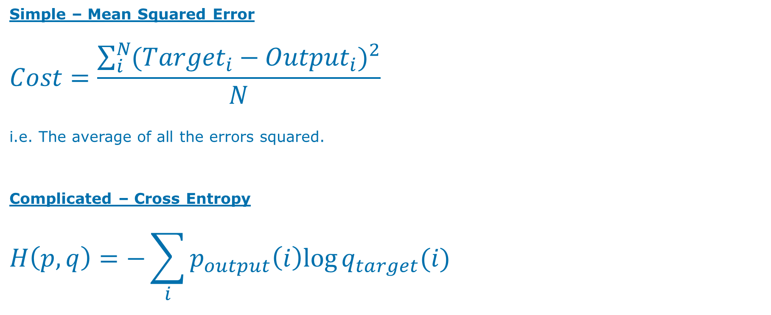
Error/Cost Functions
Simple – Mean Squared Error
$$Cost=\frac{\sum_{i}^{N}{({{Target}_{i}−{Output}_{i})}^{2}}}{N}$$
i.e. The average of all the errors squared.
Complicated – Cross Entropy
$$H\left(p,q\right)=−\sum_{i}{p_{output}\left(i\right)log⁡q_{target}(i)}$$

Slide 58
Learning Algorithms
The learning algorithm is the process of taking the cost, and using it to make changes to the weights and thresholds of the model.
i.e. in the above example we would start walking southeast for 200 metres.
One of the most common family of learning algorithms is Gradient Descent.

Slide 59

Gradient Descent
Lets take a simple example with the MSE cost function: $Cost=\frac{\sum_{i}^{N}{({{Target}_{i}−{Output}_{i})}^{2}}}{N}$
Target | Output | (Target-Output) | Cost
3 | 0
3 | 1
3 | 2
3 | 3
3 | 4
3 | 5
3 | 6

Slide 60
Gradient Descent
Lets take a simple example with the MSE cost function: $Cost=\frac{\sum_{i}^{N}{({{Target}_{i}−{Output}_{i})}^{2}}}{N}$
Target | Output | (Target-Output) | Cost
3 | 0
3 | 1
3 | 2
3 | 3 | 0 | 0
3 | 4
3 | 5
3 | 6

Slide 61
Gradient Descent
Lets take a simple example with the MSE cost function: $Cost=\frac{\sum_{i}^{N}{({{Target}_{i}−{Output}_{i})}^{2}}}{N}$
Target | Output | (Target-Output) | Cost
3 | 0
3 | 1 | 2 | 4
3 | 2
3 | 3 | 0 | 0
3 | 4
3 | 5 | -2 | 4
3 | 6

Slide 62
Gradient Descent
Lets take a simple example with the MSE cost function: $Cost=\frac{\sum_{i}^{N}{({{Target}_{i}−{Output}_{i})}^{2}}}{N}$
Target | Output | (Target-Output) | Cost
3 | 0 | 3 | 9
3 | 1 | 2 | 4
3 | 2 | 1 | 1
3 | 3 | 0 | 0
3 | 4 | -1 | 1
3 | 5 | -2 | 4
3 | 6 | -3 | 9

Slide 63
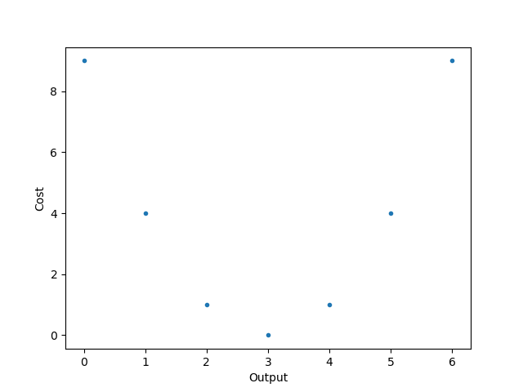
Gradient Descent
Lets take a simple example with the MSE cost function: $Cost=\frac{\sum_{i}^{N}{({{Target}_{i}−{Output}_{i})}^{2}}}{N}$
Target | Output | Diff (T-O) | Cost
3 | 0 | 3 | 9
3 | 1 | 2 | 4
3 | 2 | 1 | 1
3 | 3 | 0 | 0
3 | 4 | -1 | 1
3 | 5 | -2 | 4
3 | 6 | -3 | 9

Slide 64
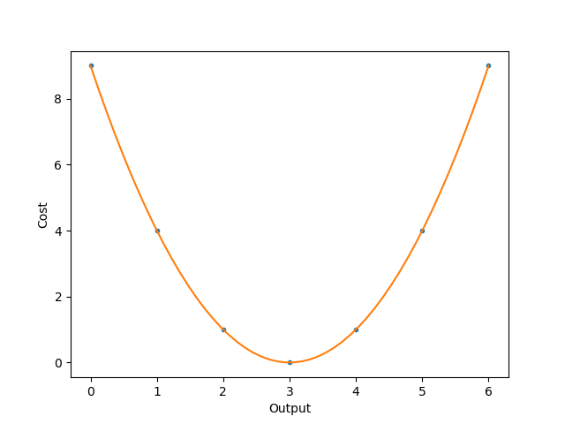
Gradient Descent
Lets take a simple example with the MSE cost function: $Cost=\frac{\sum_{i}^{N}{({{Target}_{i}−{Output}_{i})}^{2}}}{N}$
Target | Output | Diff (T-O) | Cost
3 | 0 | 3 | 9
3 | 1 | 2 | 4
3 | 2 | 1 | 1
3 | 3 | 0 | 0
3 | 4 | -1 | 1
3 | 5 | -2 | 4
3 | 6 | -3 | 9

Slide 65
Gradient Descent
Lets take a simple example with the MSE cost function: $Cost=\frac{\sum_{i}^{N}{({{Target}_{i}−{Output}_{i})}^{2}}}{N}$
Target | Output | Diff (T-O) | Cost
3 | 0 | 3 | 9
3 | 1 | 2 | 4
3 | 2 | 1 | 1
3 | 3 | 0 | 0
3 | 4 | -1 | 1
3 | 5 | -2 | 4
3 | 6 | -3 | 9

Slide 66
Gradient Descent
Lets take a simple example with the MSE cost function: $Cost=\frac{\sum_{i}^{N}{({{Target}_{i}−{Output}_{i})}^{2}}}{N}$
Target | Output | Diff (T-O) | Cost
3 | 0 | 3 | 9
3 | 1 | 2 | 4
3 | 2 | 1 | 1
3 | 3 | 0 | 0
3 | 4 | -1 | 1
3 | 5 | -2 | 4
3 | 6 | -3 | 9

Slide 67
Gradient Descent
Lets take a simple example with the MSE cost function: $Cost=\frac{\sum_{i}^{N}{({{Target}_{i}−{Output}_{i})}^{2}}}{N}$
Target | Output | Diff (T-O) | Cost
3 | 0 | 3 | 9
3 | 1 | 2 | 4
3 | 2 | 1 | 1
3 | 3 | 0 | 0
3 | 4 | -1 | 1
3 | 5 | -2 | 4
3 | 6 | -3 | 9

Slide 68
Gradient Descent
Lets take a simple example with the MSE cost function: $Cost=\frac{\sum_{i}^{N}{({{Target}_{i}−{Output}_{i})}^{2}}}{N}$
Target | Output | Diff (T-O) | Cost
3 | 0 | 3 | 9
3 | 1 | 2 | 4
3 | 2 | 1 | 1
3 | 3 | 0 | 0
3 | 4 | -1 | 1
3 | 5 | -2 | 4
3 | 6 | -3 | 9

Slide 69
Gradient Descent
Lets take a simple example with the MSE cost function: $Cost=\frac{\sum_{i}^{N}{({{Target}_{i}−{Output}_{i})}^{2}}}{N}$
Target | Output | Diff (T-O) | Cost
3 | 0 | 3 | 9
3 | 1 | 2 | 4
3 | 2 | 1 | 1
3 | 3 | 0 | 0
3 | 4 | -1 | 1
3 | 5 | -2 | 4
3 | 6 | -3 | 9

Slide 70
Gradient Descent
Lets take a simple example with the MSE cost function: $Cost=\frac{\sum_{i}^{N}{({{Target}_{i}−{Output}_{i})}^{2}}}{N}$
Target | Output | Diff (T-O) | Cost
3 | 0 | 3 | 9
3 | 1 | 2 | 4
3 | 2 | 1 | 1
3 | 3 | 0 | 0
3 | 4 | -1 | 1
3 | 5 | -2 | 4
3 | 6 | -3 | 9
Oh no!

Slide 71
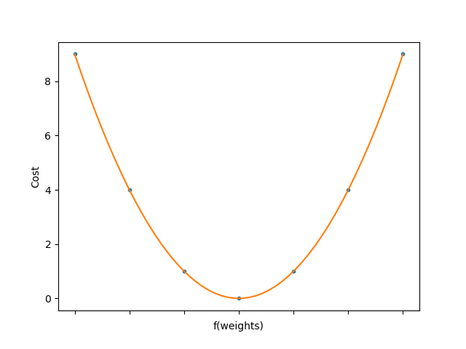
Gradient Descent
Lets take a simple example with the MSE cost function: $Cost=\frac{\sum_{i}^{N}{({{Target}_{i}−{Output}_{i})}^{2}}}{N}$
Target | Output | Diff (T-O) | Cost
3 | 0 | 3 | 9
3 | 1 | 2 | 4
3 | 2 | 1 | 1
3 | 3 | 0 | 0
3 | 4 | -1 | 1
3 | 5 | -2 | 4
3 | 6 | -3 | 9
Output = f(weights)

Slide 72
Run ‘mnist_tutorial_training.py’ Coding the cost and learning algorithm. Lines 189-226 Training the model. Lines 227-252

Slide 73
Run ‘mnist_tutorial_testing.py’ Testing the model. Lines 255-280

Slide 74
Opening the Black Box
Artificial Neural Networks are sometimes described as ‘Black Boxes’ i.e. we can’t see or understand their inner workings.
Overcoming this problem is one of the main frontiers for ANN research.
However for a simple network like this, we can easily visualise the weights, and thus try to understand the inner workings of the network.

Slide 75
MNIST Network
S₀
P(0)
S₁
P(1)
In₁
S₂
P(2)
S₃
P(3)
In₁
S₄
P(4)
In₃
S₅
P(5)
.
.
.
S₆
P(6)
S₇
P(7)
In₇₈₄
S₈
P(8)
S₉
P(9)
INPUTS
WEIGHTS
Sigmoid
Perceptrons
OUTPUT

Slide 76
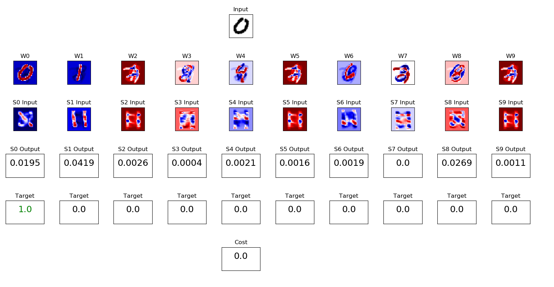
MNIST Network
In₁
In₁
In₃
.
.
.
In₇₈₄
INPUTS

Slide 77
MNIST Network – Weight Visualisation
S₀
P(0)
S₁
P(1)
In₁
S₂
P(2)
S₃
P(3)
In₁
S₄
P(4)
In₃
S₅
P(5)
.
.
.
S₆
P(6)
S₇
P(7)
In₇₈₄
S₈
P(8)
S₉
P(9)

Slide 78
MNIST Network – Network Visualisation
S₀
S₁
In₁
S₂
S₃
In₁
S₄
In₃
S₅
.
.
.
S₆
S₇
In₇₈₄
S₈
S₉

Slide 79
MNIST Network – Network Visualisation
S₀
P(0)
S₁
P(1)
S₂
P(2)
S₃
P(3)
S₄
P(4)
S₅
P(5)
S₆
P(6)
S₇
P(7)
S₈
P(8)
S₉
P(9)

Slide 80
MNIST Network – Network Visualisation
Target/Label of the input
Cost/Error Function output

Slide 81
MNIST Network – Network Visualisation
Most networks are considerably more complex then this one.
With just a bit of added complexity (of both the network and the problem) it rapidly becomes difficult, if not impossible, to explain how it works.
Because of this developing and using ANNs often requires a healthy dose of experimentation and luck.
Despite this, understanding the key ideas behind them will help guide your experiments. And even for complex models, the basics can help point you in the right direction when they are not performing as expected.

Slide 82
MNIST Network – Network Visualisation
Most networks are considerably more complex then this one.
With just a bit of added complexity (of both the network and the problem) it rapidly becomes difficult, if not impossible, to explain how it works.
Because of this developing and using ANNs often requires a healthy dose of experimentation and luck.
Despite this, understanding the key ideas behind them will help guide your experiments. And even for complex models, the basics can help point you in the right direction when they are not performing as expected.
BLACK BOX ≠ Skynet

Slide 83
Opening the Black Box run ‘mnist_tutorial_visualization.py’

Slide 84
Further Study
Going deeper: ANNs as a matrix/tensor, different activation functions, cost functions & learning functions.
Going higher: Keras, higher level APIs, Opensource software
Different model architectures for different jobs – Convolutional, Recurrent, GANs.
How to save a model and export it to another system, and other practicalities of implementing ANNs.
ANNs on GPUs.

Slide 85
Further Discussion
AI in Capgemini
Low-hanging fruit: the next steps in enterprise level AI
Ethics discussion (Skynet/Terminator/HAL will be banned)
Artificial General Intelligence i.e. how close are we to human-like AI?

Slide 86
Acknowledgements & Sources
Much of the code comes from the following tutorial:
https://www.oreilly.com/learning/not-another-mnist-tutorial-with-tensorflow
This YouTube tutorial is a very good introduction to Neural Networks:
https://www.youtube.com/watch?v=aircAruvnKk&list=PLZHQObOWTQDNU6R1_67000Dx_ZCJB-3pi
The textbook:
S. Russell and P. Norvig, Artificial Intelligence: A Modern Approach, 3rd ed: Pearson, 2016
And to the AI CoE group for sitting through the first draft of this tutorial.

Slide 87
Appendix A
Glossary

Slide 88
Appendix B
A mathematical dive into the model:
Sigmoid Activation Functions and others
Thresholds as Bias

Slide 89
Artificial Neural Networks
An area of AI/Machine learning inspired by natural intelligence.
ANNs are at their heart a mathematical model of a biological neural network.

Slide 90
Biological Neuron
A single cell.
Uses chemical gradients to send an ‘Action Potential’, i.e. a signal, down its stem.
All or Nothing: it will only fire it receives enough stimulus to do so, otherwise it is inactive.

Slide 91
Biological Neural Networks
Multiple discrete units, i.e. Neurons, forming a network.
Each neuron receives Neurotransmitters at on end, and releases them at the other end, to transmit the signals between them
NT
NT
NT
NT
NT
NT
NT

Slide 92
All-Or-Nothing
A neurone will only fire if it receives enough input to overcome a threshold.
In biology this ‘input’ is in the form of chemicals (neurotransmitters).
i.e. if a neurone receives enough chemicals (in a period of time), it will fire.
NT
NT
NT

Slide 93
All-Or-Nothing
A neurone will only fire if it receives enough input to overcome a threshold.
In biology this ‘input’ is in the form of chemicals (neurotransmitters).
i.e. if a neurone receives enough chemicals (in a period of time), it will fire.
NT
NT
NT
NT
NT
NT
NT
NT
NT
NT
NT
NT
NT

Slide 94
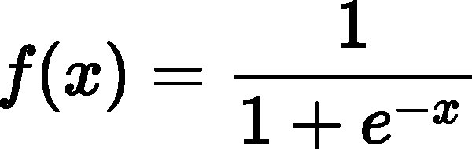
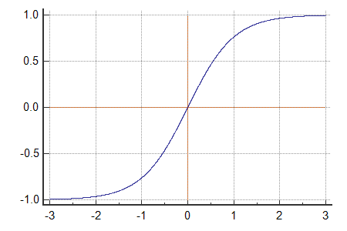
All-Or-Nothing - Mathematically AKA Activation Functions
Sigmoid Function
Tanh

Slide 95
Neurone - Mathematically
NT
NT
NT
NT
NT
NT
NT
NT
NT
NT
NT
NT
NT
Inputs
Activation function of the total inputs
Output

Slide 96
Neurone - Mathematically
NT
NT
NT
NT
NT
NT
NT
NT
NT
NT
NT
NT
NT
Inputs
S(Inputs)
Output

Slide 97
Neurone - Mathematically
NT
NT
NT
NT
NT
NT
NT
NT
NT
NT
NT
NT
NT
Inputs
S(Inputs)
Output
Each input neurone will have a differing impact on the following neurone.

Slide 98
Neurone - Mathematically
NT
NT
NT
NT
NT
NT
NT
NT
NT
NT
NT
NT
NT
Inputs
&
Weight
S(Inputs x Weights)
Output
Each input neurone will have a differing impact on the following neurone.

Slide 99
Neurone - Mathematically
NT
NT
NT
NT
NT
NT
NT
NT
NT
NT
NT
NT
NT
Inputs
&
Weight
S(Inputs x Weights)
Output
One thing we’re forgetting…..

Slide 100
Neurone - Mathematically
NT
NT
NT
NT
NT
NT
NT
NT
NT
NT
NT
NT
NT
Inputs
&
Weight
S(Inputs x Weights)
Output
A neurone will only fire if it receives enough input to overcome a threshold.

Slide 101
Neurone - Mathematically
NT
NT
NT
NT
NT
NT
NT
NT
NT
NT
NT
NT
NT
Inputs
&
Weight
S((Inputs x Weights)-Threshold)
Output
A neurone will only fire if it receives enough input to overcome a threshold.

Slide 102
Neurone - Mathematically
Input₁
Weight₁
NT
Input₂
Weight₂
NT
NT
Weight₃
Input₃
Inputs
&
Weight
S((Inputs x Weights)-Threshold)
Output

Slide 103
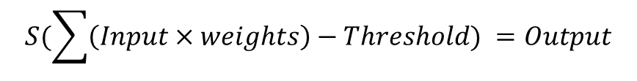
Neurone – Mathematically AKA “perceptron”
Input₁
Weight₁
$$S(\sum{\left(Input×weights\right)−Threshold) =Output}$$
Input₂
Weight₂
Weight₃
Input₃
Inputs
&
Weight
S((Inputs x Weights)-Threshold)
Output

Slide 104
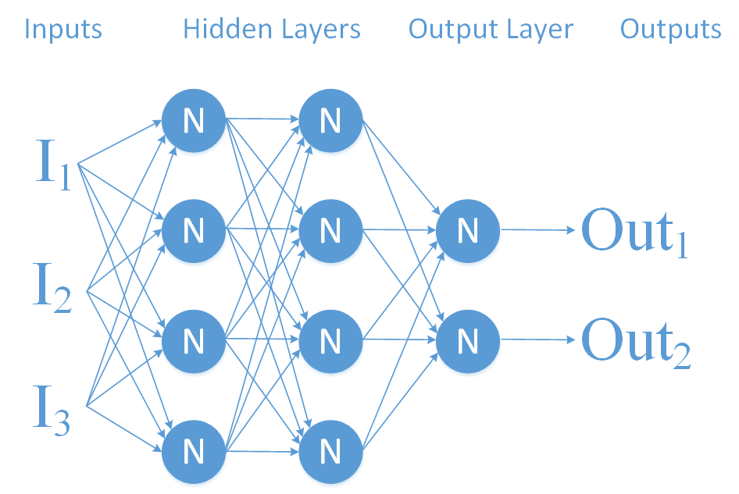
Artificial Neural Networks
ANNs are at their heart a mathematical model of a biological neural network.
Key Elements:
Multiple discrete units forming a network
Step Function
?????

Slide 105
Artificial Neuron - Perceptron
A Neuron can be very simply represented by a mathematical function, that will only fire (produce an output of 1), if the total input exceeds a threshold.
This function is often called the Step Function or Activation function.
S
Input
1 or 0
Input
Input

Slide 106
Artificial Neural Networks
S
We can now form a network of these individual perceptrons to form an Artificial Neural Network.
Each arrow represents the output of the left Perceptron being piped to the next Perceptron as one of its inputs.
These arrows are weighted, so some Perceptron to Perceptron links are more important then others.
S
S
S
S
S
S
S
S
S
S
S
S
S
S
S

Slide 107
Artificial Neural Networks
S_{o} will only fire if the following combinations fire:
S_{a}, S_{b}, S_{c}
S_{a}, S_{b}
S_{a}, S_{c}
S_{a}
W = 3
S_{b}
W = 2
S_{o}
W = 1
Threshold = 4
S_{c}

Slide 108
Appendix C
MNIST Network – SoftMax activation function

Slide 109
MNIST Network
Pixel₁
Pixel₂
Pixel₃
.
.
.
.
.
.
Pixel₇₈₄

Slide 110
MNIST Network
W₁
Pixel₁
Pixel₂
W₂
Pixel₃
W₃
.
.
.
.
.
.
W₇₈₄
Pixel₇₈₄
INPUTS
WEIGHTS

Slide 111
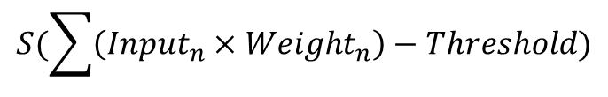
MNIST Network
Pixel₁
Pixel₂
W₁
W₂
Pixel₃
W₃
.
.
.
.
.
.
$$S(\sum{\left({Input}_{n}×{Weight}_{n}\right)−Threshold)}$$
W₇₈₄
Pixel₇₈₄
INPUTS
WEIGHTS
Activation Function

Slide 112
MNIST Network
S(x)
Pixel₁
S(x)
Pixel₂
S(x)
Pixel₃
S(x)
.
.
.
.
.
.
S(x)
S(x)
S(x)
S(x)
Pixel₇₈₄
S(x)
S(x)
INPUTS
WEIGHTS
Activation Function

Slide 113
MNIST Network
S(x)
1 = yes, 0 = no
0
Pixel₁
S(x)
1 = yes, 0 = no
1
Pixel₂
S(x)
1 = yes, 0 = no
2
Pixel₃
S(x)
1 = yes, 0 = no
3
.
.
.
.
.
.
S(x)
1 = yes, 0 = no
4
S(x)
1 = yes, 0 = no
5
S(x)
1 = yes, 0 = no
6
S(x)
1 = yes, 0 = no
7
Pixel₇₈₄
S(x)
1 = yes, 0 = no
8
S(x)
1 = yes, 0 = no
9
INPUTS
WEIGHTS
Activation Function
OUTPUT

Slide 114
MNIST Network
S(x)
1 = yes, 0 = no
0
Pixel₁
S(x)
1 = yes, 0 = no
1
Pixel₂
But with this network, every digit could be a ‘1’.
i.e. the input picture is 100% definitely a 1, 2 ,3 ,4,… & 9 all at the same time.
This is obviously silly.
S(x)
1 = yes, 0 = no
2
Pixel₃
S(x)
1 = yes, 0 = no
3
.
.
.
.
.
.
S(x)
1 = yes, 0 = no
4
S(x)
1 = yes, 0 = no
5
S(x)
1 = yes, 0 = no
6
S(x)
1 = yes, 0 = no
7
Pixel₇₈₄
S(x)
1 = yes, 0 = no
8
S(x)
1 = yes, 0 = no
9
INPUTS
WEIGHTS
Activation Function
OUTPUT

Slide 115
MNIST Network
S(x)
1 = yes, 0 = no
0
This single softmax function gives 10 outputs that add up to 1.
Each output can be interpreted as the probability that the input is that output.
Pixel₁
S(x)
1 = yes, 0 = no
1
Pixel₂
S(x)
1 = yes, 0 = no
2
Pixel₃
S(x)
1 = yes, 0 = no
3
.
.
.
.
.
.
S(x)
1 = yes, 0 = no
4
S(x)
1 = yes, 0 = no
5
S(x)
1 = yes, 0 = no
6
S(x)
1 = yes, 0 = no
7
Pixel₇₈₄
S(x)
1 = yes, 0 = no
8
S(x)
1 = yes, 0 = no
9
INPUTS
WEIGHTS
SoftMax Function
OUTPUT

Slide 116
MNIST Network
S(x)
0.025
0
This single softmax function gives 10 outputs that add up to 1.
Each output can be interpreted as the probability that the input is that output.
So in this example, the model predicts input is most likely to be a ‘5’.
Pixel₁
S(x)
0.025
1
Pixel₂
S(x)
0.025
2
Pixel₃
S(x)
0.025
3
.
.
.
.
.
.
S(x)
0.025
4
S(x)
0. 5
5
S(x)
0.2
6
S(x)
0.025
7
Pixel₇₈₄
S(x)
0.1
8
S(x)
0.05
9
INPUTS
WEIGHTS
SoftMax Function
OUTPUT

Slide 117
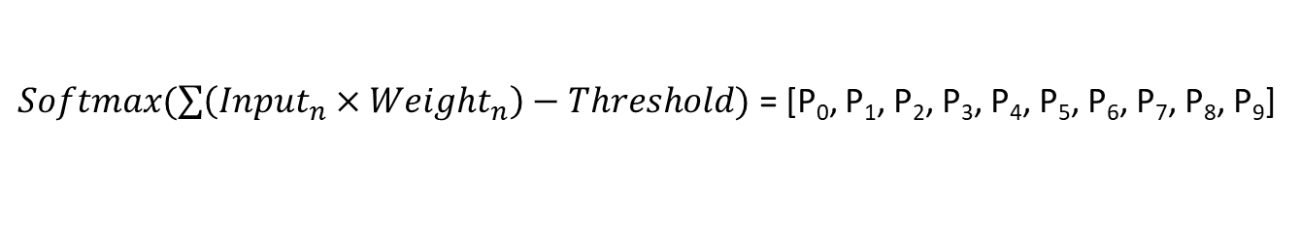
MNIST Network
S(x)
P₀
Pixel₁
S(x)
P₁
Pixel₂
S(x)
P₂
Pixel₃
S(x)
P₃
.
.
.
.
.
.
S(x)
P₄
S(x)
P₅
S(x)
P₆
S(x)
P₇
Pixel₇₈₄
S(x)
P₈
S(x)
P₉
$Softmax(\sum{\left({Input}_{n}×{Weight}_{n}\right)−Threshold)}$ = [P₀, P₁, P₂, P₃, P₄, P₅, P₆, P₇, P₈, P₉]

Slide 118
Appendix D
Cost Functions

Slide 119
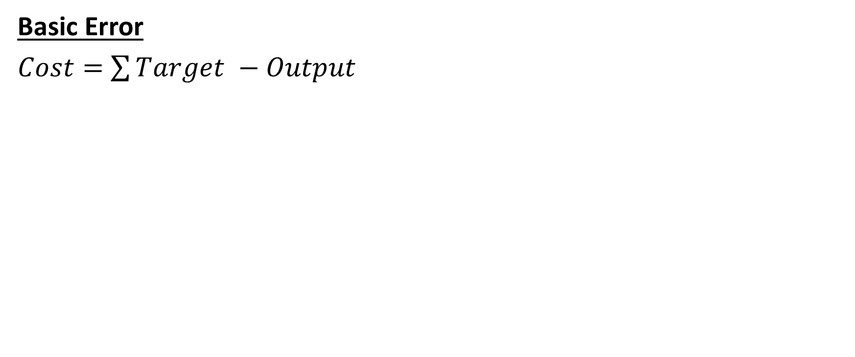
Error/Cost Functions
Basic Error
$Cost=$ $\sum{Target −Output}$

Slide 120
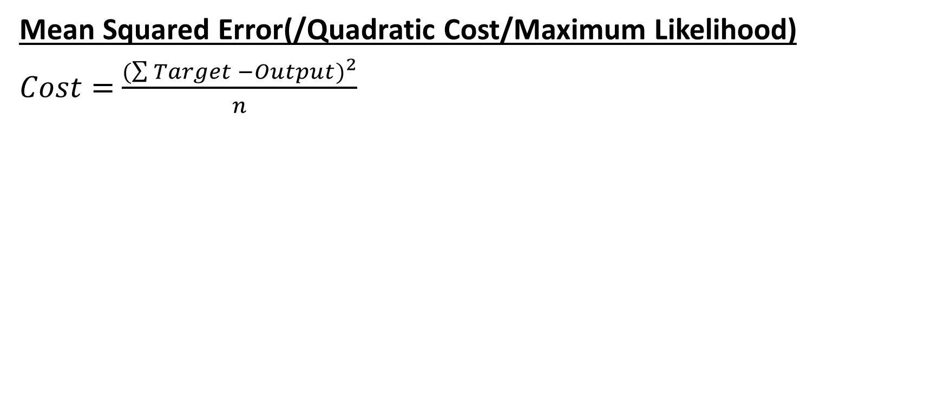
Error/Cost Functions
Mean Squared Error(/Quadratic Cost/Maximum Likelihood)
$Cost=$ $\frac{{(\sum{Target −Output})}^{2}}{n}$

Slide 121
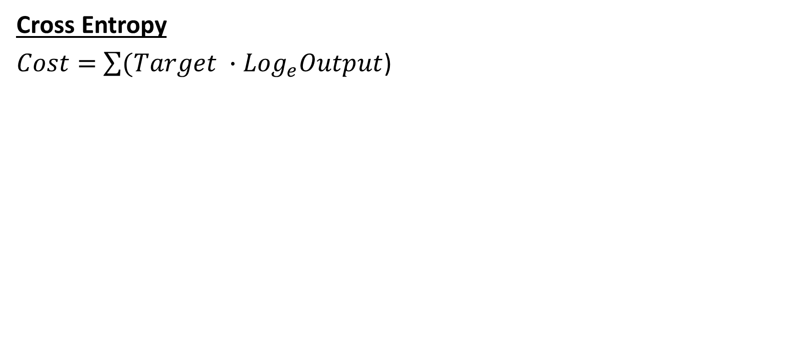
Error/Cost Functions
Cross Entropy
$Cost=$ $\sum{(Target ∙{Log}_{e}Output}$)
This cost function is well suited to training classification models, whose out put is between 0-1

Slide 122
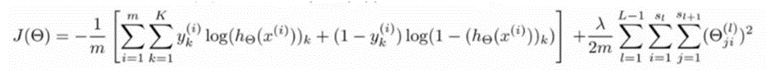
Error/Cost Functions
Simple
Cost = Target – Output
Complicated
I have no idea what this means…

Slide 123
Appendix D
Learning Funcstions
(Gradient Descent)

Slide 124
AI & Machine Learning
Artificial Intelligence
“Collection of capabilities and behaviours by systems that are perceived by humans as intelligent”
Anne Thieullent, Capgemini Global Head of AI
Machine Learning
Machine learning is a field of computer science that uses statistical techniques to give computer systems the ability to "learn" (e.g., progressively improve performance on a specific task) with data, without being explicitly programmed.
https://en.wikipedia.org/wiki/Machine_learning

Slide 125
Optical Character Recognition
One if the sub-cases of Artificial Intelligence: the ability to recognise typed and hand-written characters/digits/words.
Multiple use-cases in both business and personal life.
A specific enough task that it is reasonable for modern AI techniques.

Slide 126
MNIST Network
S₀(x)
P(0)
This single SoftMax function (consisting of 10 Step functions) gives 10 outputs that add up to 1.
Each output can be interpreted as a probability.
So in this example P(5) should be the highest output.
Pixel₁
S₁(x)
P(1)
Pixel₂
S₂(x)
P(2)
Pixel₃
S₃(x)
P(3)
.
.
.
.
.
.
S₄(x)
P(4)
S₅(x)
P(5)
S₆(x)
P(6)
S₇(x)
P(7)
Pixel₇₈₄
S₈(x)
P(8)
S₉(x)
P(9)
INPUTS
WEIGHTS
SoftMax Function
OUTPUT

Slide 127
MNIST Network
S₀(x)
0.025
This single SoftMax function (consisting of 10 Step functions) gives 10 outputs that add up to 1.
Each output can be interpreted as a probability.
So in this example P(5) should be the highest output.
Pixel₁
S₁(x)
0.025
Pixel₂
S₂(x)
0.025
Pixel₃
S₃(x)
0.025
.
.
.
.
.
.
S₄(x)
0.025
S₅(x)
0.5
S₆(x)
0.2
S₇(x)
0.025
Pixel₇₈₄
S₈(x)
0.1
S₉(x)
0.05
INPUTS
WEIGHTS
SoftMax Function
OUTPUT
Notes:
And low and behold it is!

Slide 128
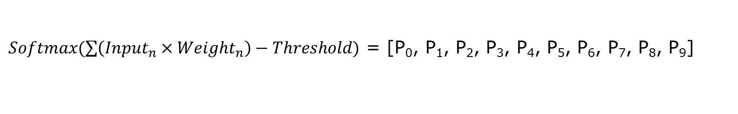
MNIST Network
S₀(x)
0.025
Pixel₁
S₁(x)
0.025
Pixel₂
S₂(x)
0.025
Pixel₃
S₃(x)
0.025
.
.
.
.
.
.
S₄(x)
0.025
S₅(x)
0. 5
S₆(x)
0.2
S₇(x)
0.025
Pixel₇₈₄
S₈(x)
0.1
S₉(x)
0.05
$Softmax(\sum{\left({Input}_{n}×{Weight}_{n}\right)−Threshold)}$ = [P₀, P₁, P₂, P₃, P₄, P₅, P₆, P₇, P₈, P₉]
Notes:
The equation is wrong and needs fixing

Slide 129
MNIST Network
S₀(x)
0.025
Pixel₁
S₁(x)
0.025
Pixel₂
S₂(x)
0.025
Pixel₃
S₃(x)
0.025
.
.
.
.
.
.
S₄(x)
0.025
S₅(x)
0. 5
S₆(x)
0.2
S₇(x)
0.025
Pixel₇₈₄
S₈(x)
0.1
S₉(x)
0.05
WRONG
$Softmax(\sum{\left({Input}_{n}×{Weight}_{n}\right)−Threshold)}$ = [P₀, P₁, P₂, P₃, P₄, P₅, P₆, P₇, P₈, P₉]
Notes:
The equation is wrong and needs fixing, buts it’s a useful simplification.

Slide 130
MNIST Network
S₀
P(0)
S₁
P(1)
S₂
P(2)
This single Sigmoid layer gives 10 outputs between 0 and 1.
Each output can be interpreted as a probability, with 1 being the highest (100% certainty that it is that digit).
So in this example P(5) should be the highest output.
S₃
P(3)
S₄
P(4)
S₅
P(5)
S₆
P(6)
S₇
P(7)
S₈
P(8)
S₉
P(9)
INPUTS
WEIGHTS
Sigmoid
Perceptrons
OUTPUT

Slide 131
MNIST Network
S₀
P(0)
S₁
P(1)
S₂
P(2)
This single Sigmoid layer gives 10 outputs between 0 and 1.
Each output can be interpreted as a probability, with 1 being the highest (100% certainty that it is that digit).
So in this example P(5) should be the highest output.
S₃
P(3)
S₄
P(4)
S₅
P(5)
S₆
P(6)
S₇
P(7)
S₈
P(8)
S₉
P(9)

Slide 132
MNIST Network
S₀
P(0)
S₁
P(1)
S₂
P(2)
This single Sigmoid layer gives 10 outputs between 0 and 1.
Each output can be interpreted as a probability, with 1 being the highest (100% certainty that it is that digit).
So in this example P(5) should be the highest output.
S₃
P(3)
S₄
P(4)
S₅
P(5)
S₆
P(6)
S₇
P(7)
S₈
P(8)
S₉
P(9)

Slide 133
MNIST Network
S₀
P(0)
S₁
P(1)
S₂
P(2)
This single Sigmoid layer gives 10 outputs between 0 and 1.
Each output can be interpreted as a probability, with 1 being the highest (100% certainty that it is that digit).
So in this example P(5) should be the highest output.
S₃
P(3)
S₄
P(4)
S₅
P(5)
S₆
P(6)
S₇
P(7)
S₈
P(8)
S₉
P(9)

Slide 134
MNIST Network
S₀
P(0)
S₁
P(1)
S₂
P(2)
This single Sigmoid layer gives 10 outputs between 0 and 1.
Each output can be interpreted as a probability, with 1 being the highest (100% certainty that it is that digit).
So in this example P(5) should be the highest output.
S₃
P(3)
S₄
P(4)
S₅
P(5)
S₆
P(6)
S₇
P(7)
S₈
P(8)
S₉
P(9)

